Slide 1


MYSQL CASE STUDY PROJECT
WHOLE FOOD MARKET DATA ANALYSIS
https://github.com/Luckshaya
https://www.codingninjas.com/studio/profile/Luckshaya_Kem
www.linkedin.com/in/luckshaya-kem

Slide 2
CASE STATEMENT
The big multinational company "Whole Foods market" wants to revamp their retail strategy in India. You as a newly hired Data Analyst have been asked to be a part of the project. Your job is to provide analytical support to the business in making business decisions.
You have been provided with some data around orders placed at various locations in India, people who have returned the items, and customers. All the data has been loaded into MySql and you are required to write SQL queries to help the company make better decisions.
www.linkedin.com/in/luckshaya-kem

Slide 3
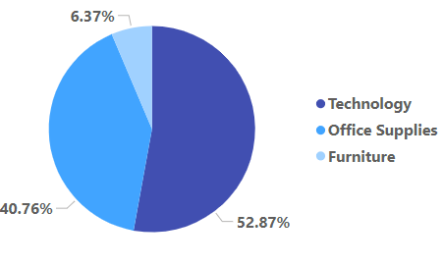
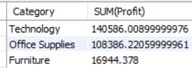
FIND OUT WHICH CATEGORY IS PERFORMING BETTER IN TERMS OF PROFIT
SELECT Category, SUM(Profit) FROM orders
GROUP BY Category
ORDER BY SUM(PROFIT) DESC

Slide 4

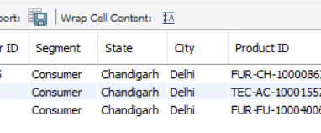
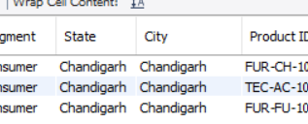
UPDATE THE CITY AS CHANDIGARH WHERE THE STATE IS CHANDIGARH.
SET SQL_SAFE_UPDATES = 0;
UPDATE market SET City = 'Chandigarh'
WHERE State = 'Chandigarh';
SELECT * FROM orders
Used to remove ERROR1175 i.e, using safe update mode

Slide 5


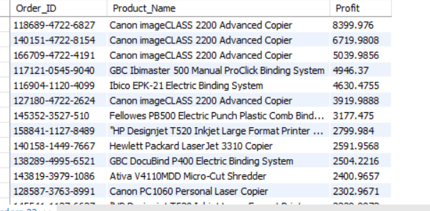
HOW MUCH COMPANY PROFIT HAS BEEN GENERATED BY THE COMPANY SO FAR.
SELECT SUM(Profit) FROM orders
GET THE ORDERID, PRODUCTNAME AND PROFIT. RESULT SHOULD BE WITH RESPECT TO PROFIT(IN DECREASING ORDER)
SELECT Order_ID, Product_Name, Profit FROM orders
WHERE Profit > 0
ORDER BY PROFIT DESC

Slide 6
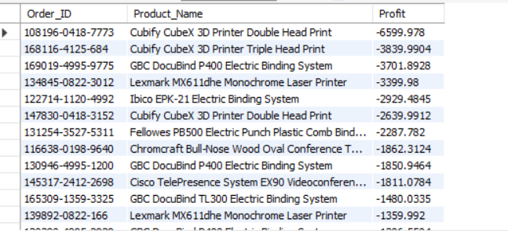
GET ALL THE ORDERS WHERE THERE WAS A LOSS AND REPORT THE ORDER ID, PRODUCT NAME AND LOSS. SORT THE RESULT IN A FORMAT THAT THE HIGHEST LOSS IS ON THE TOP.
SELECT Order_ID, Product_Name, Profit FROM orders
WHERE Profit < 0
ORDER BY PROFIT

Slide 7
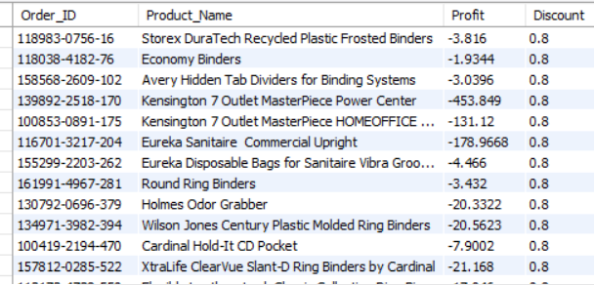
GET THE LIST OF ALL ORDERS WHICH HAVE LOSS AND SORT THEM IN DESCENDING ORDER OF DISCOUNT GIVEN.
Print OrderID, ProductName, Profit and Discount.
SELECT Order_ID, Product_Name, Profit, Discount FROM orders
WHERE Profit < 0
ORDER BY Discount DESC

Slide 8
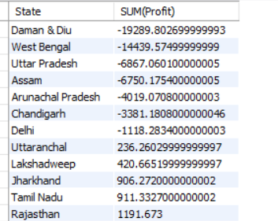
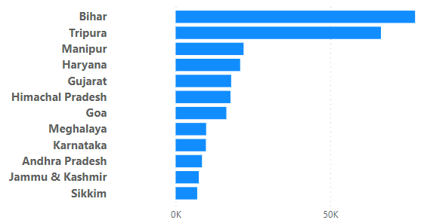
GET THE STATE AND SUM OF PROFIT FOR EACH STATE. THE RESULT SHOULD BE IN INCREASING ORDER OF PROFIT.
SELECT State, SUM(Profit) from orders
GROUP BY State
ORDER BY SUM(Profit)

Slide 9
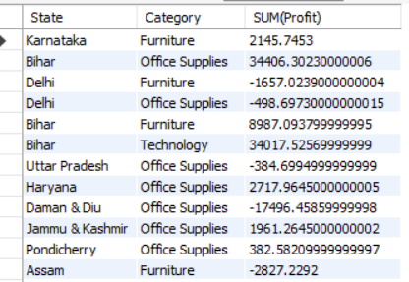
GET STATE, CATEGORY AND SUM OF PROFITS.
SELECT State, Category, SUM(Profit) FROM orders
GROUP BY State, Category

Slide 10
You realised that there are three segments of products: Consumer, Corporate and Home office. You ask your manager to provide you a list of the people who are managing these segments. Unfortunately these are not present in the database. Since you want to digitise the system, you plan to put the data in the database. He provides you the data on a sheet of paper as follows:
Segment - Varchar(100)
Segment_Manager- Varchar(100)
WRITE A QUERY TO CREATE A TABLE IN THE DATABASE WITH NAME AS MANAGER AND WITH VALUES PROVIDED. DO ASSIGN PROPER PRIMARY KEY.

Slide 11
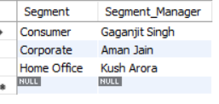
CREATE TABLE Manager (Segment Varchar(100) PRIMARY KEY, Segment_Manager Varchar(100));
INSERT INTO Manager VALUES ('Consumer','Gaganjit Singh');
INSERT INTO Manager VALUES ('Corporate','Aman Jain');
INSERT INTO Manager VALUES ('Home Office','Kush Arora');
SELECT * from manager

Slide 12
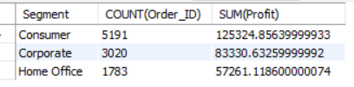
GET SEGMENT, COUNT OF ORDER, SUM OF PROFIT.
SELECT Segment, COUNT(Order_ID), SUM(Profit) FROM orders
GROUP BY Segment

Slide 13


GET SUM OF SALES, SUM OF PROFIT FOR THE YEAR 2020.
SELECT SUM(Sales), SUM(Profit) FROM orders
WHERE Order_Date Like '%20'
GET THE SUM OF SALES OF EACH SEGMENT AND THEIR RESPECTIVE SEGMENT MANAGER FOR ALL YEARS EXCEPT 2020.
SELECT SUM(orders.Sales),manager.Segment_Manager FROM orders
LEFT JOIN manager
ON orders.Segment = manager.Segment
WHERE Order_Date NOT LIKE '%20'
GROUP BY orders.Segment

Slide 14
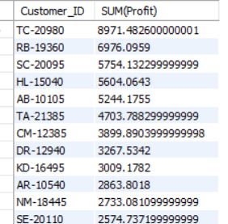
ANALYSIS AT CUSTOMER LEVEL
GET CUSTOMER ID AND SUM OF PROFIT FOR EACH. THE RESULT SHOULD BE SUCH THAT YOU ARE EASILY ABLE TO FIND THE HIGHEST PROFIT CUSTOMER.
SELECT Customer_ID, SUM(Profit) FROM orders
GROUP BY Customer_ID
ORDER BY SUM(Profit) DESC

Slide 15
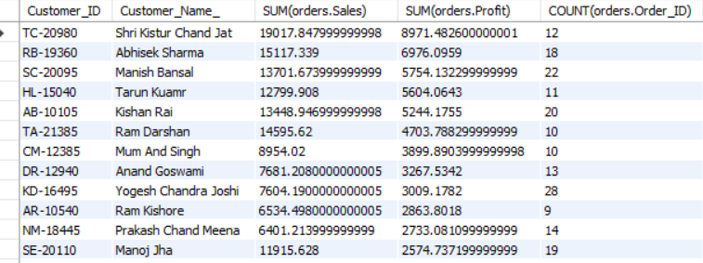
FIND THE CUSTOMER DETAILS HAVING THE HIGHEST PROFIT. THE RESULT SHOULD BE SUCH THAT YOU ARE EASILY ABLE TO FIND THE HIGHEST PROFITABLE CUSTOMER.
The query should have columns : Customer_ID, Customer_Name_, sum of Sales, sum of Profit, count of Order_ID.
SELECT orders.Customer_ID, customers.Customer_Name_, SUM(orders.Sales), SUM(orders.Profit), COUNT(orders.Order_ID) FROM orders
JOIN customers
ON orders.Customer_ID = customers.Customer_ID
GROUP BY orders.Customer_ID, customers.Customer_Name_
ORDER BY SUM(orders.Profit) DESC

Slide 16
Thank
you!

